Slide 1
Temporal Netgrid Model-Based Dynamic Routing in Large-Scale
Small Satellite Networks
IEEE TRANSACTIONS ON VEHICULAR TECHNOLOGY, VOL. 68, NO. 6, JUNE 2019
Jian Li , Hancheng Lu , Member, IEEE, Kaiping Xue , Senior Member, IEEE,
and Yongdong Zhang , Senior Member, IEEE
Notes:
這篇主要時提出了一個不基於衛星數量與座標的一種大規模小型衛星的路由演算法，他是基於他所提出的一個叫netgrid的一種方式，簡單來說她把空間分割成好幾個立方體，基於這個netgrid來尋找最佳路徑。

Slide 2
INTRODUCTION
01
RELATED WORK
02
TABLE OF CONTENTS
04
MULTI-LAYER NETGRID PARTITION METHOD IN
LARGE-SCALE SSNS
TEMPORAL NETGRID MODEL
03
05
SIMULATION RESULTS
06
CONCLUSION

Slide 3
01
INTRODUCTION

Slide 4
In Recent years, the research on Low Earth Orbit (LEO) Small Satellite Networks (SSNs) is attracting increasing attention due to rapid growth of ubiquitous and seamless communication requirements.
Many companies such as OneWeb/Airbus, SpaceX/Google and Samsung, are planning to develop large-scale SSNs in order to establish a massive global broadband constellation that will provide worldwide Internet access.
Notes:
近幾年，由於人們對於隨時隨地且無縫的通訊需求提升，因此LEO small satellite networks的研究引起了越來越多的關注，因為跟MEO與GEO相比， LEO不僅在發射及維護上更具便利性，還能實現更高的throughput 與較短的propagation delay. 像是 Airbus的OneWeb 以及Google的SpaceX 都在著手進行大規模的小型衛星網路，以建立一個全球性的constellation 以提供全世界使用。 那根據他們的計畫表示，airbus大概會用到600多顆衛星，而google的則達到1000顆以上。

Slide 5
Schedule routing scheme:
Lots of efforts on routing design have been done to achieve efficient data delivery in satellite networks. In scheduled routing schemes, by making full use of the periodic satellite's trajectory, the topology can be predicted in advance to mitigate the on-board state collection overhead.
Opportunistic routing scheme:
In order to mitigate the overhead of collection and routing process, some studies, adopt multi-layered satellite structure and divide satellites into small-scale groups for large-scale satellite network. The basic idea is to take higher layer satellites like MEO or GEO satellites as managers who is in charge of network state collection and routing table calculation for LEO satellites. Because of the expensive cost and longer propagation delay of higher layer satellites, the multi-layered satellite structure is rarely considered in practical application.
Notes:
由於動態環境包括衛星運動和時變衛星間的連接，衛星路由比地面路由更加複雜。為了在衛星網絡中實現有效的數據傳遞，已經在路由設計上做了很多努力。在調度的路由方案中，通過充分利用周期性衛星的軌跡，可以預先預測拓撲，以減輕機載狀態收集的開銷，但因為這種schedule routing 沒辦法反映衛星網路中的實時狀況，為了解決這問題，也有人提出了 opportunistic routing ，這種routing方式主要是在每個節點去蒐集網路的狀態，但是這種方式就會造成整個網路的overhead很大，為減少這些overhead, 有些研究採取多層衛星結構，基本想法是將MEO 或GEO這種高層衛星當管理者，負責LEO的狀態蒐集與計算routing table，但因為成本昂貴，且propagation delay 比較長，所以實際應用很少考慮這種架構，也因為高度動態的拓撲變化，上述兩種routing scheme都不能直接用在大規模小型衛星上面。

Slide 6
An efficient and low-complexity routing algorithm is proposed for resource-limited small satellites to calculate the optimal data delivery path. The main contributions of this paper are summarized as follows.
We propose a time-continuous Temporal Netgrid Model (TNM) to describe the time-varying topology of large-scale SSNs. In TNM, we use static cubes (i.e., netgrids) to replace coordinates of satellites. In this way, TNM can record time-continuous topology information and only a fixed number of netgrids need to be stored at each satellite.
In order to provide different accuracy of topology description in TNM, we propose a multi-layer netgrid partition method and theoretically analyze the relationship between the number of partition layers and the description accuracy.
Based on TNM, we propose an efficient and low-complexity routing algorithm for resource-limited small satellites. Since the complexity of the proposed routing algorithm only related to the number of netgrids other than the number of satellites, its computation complexity can be significantly reduced compared with traditional satellite routing algorithms.
Notes:
本paper的主要貢獻有以下幾點：1.提出了一個時空連續的時間網格模型(以下叫他TNM)來描述大規模小型衛星的時變拓樸，在TNM中，我們使用靜態立方體(netgrids)來代替衛星座標。這樣的話TNM可以記錄時間連續的拓樸信息，並且每顆衛星僅需要儲存庫定數量的netgrids。第二點，他們提出了一種多層netgrid的劃分方法，並分析劃分層數與描述精度的關係，最後基於TNM，提出了一種高效且低複雜的路由方法，此演算法的複雜度僅與netgrid的數量有關，而與衛星的數量無關，因此跟傳統路由方法比起來複雜度可以大大降低。

Slide 7
02
Related Work

Slide 8
Scheduled routing scheme
Scheduled routing schemes attempt to make full use of periodic satellite trajectories and predictable topology variations.
Another representative scheduled routing scheme is Contact Graph Routing (CGR), which is proposed for delay tolerant networks as a promising routing scheme and has been applied in satellite communications successfully
Notes:
Scheduled routing scheme就是一開始就先進行一次路徑規劃，那每個節點根據packet上的標頭黨，來得知要下一個要轉送的是哪個節點，好處是複雜度低，但是彈性不高。

Slide 9
Opportunistic routing scheme
In opportunistic routing schemes, routing process based on on-board state collection is considered. In this way, routing can better respond to dynamic topology variations and unpredictable link interruptions. Song et al. proposed a Traffic-Light-based Routing (TLR) for non-GEO satellite IP networks.
In TLR, each orbit had a speaker to collect un-deterministic state information such as queuing delay and so on. The main contribution in TLR was that it would adjust the route dynamically according to the real-time state at intermediate nodes to avoid congestion.
Notes:
在機會路由方案中，像是TLR考慮了基於on-board狀態收集的路由過程，也就是將dijkstra應用在衛星上，在每個node的時候尋找下一個的最佳解。這樣可以更好地響應動態拓撲變化和不可預測的鏈路中斷，

Slide 10
03
TEMPORAL NETGRID MODEL

Slide 11
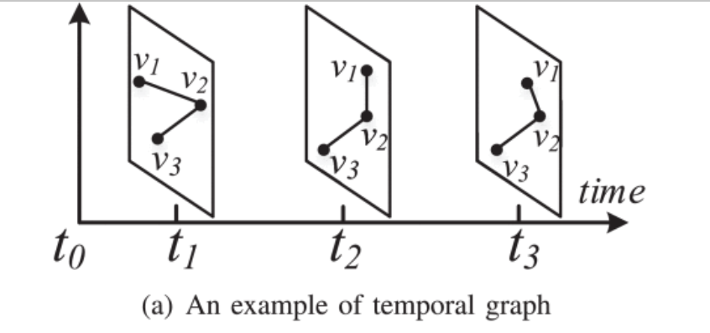

Motivation
In order to improve satellite routing performance, the predictable and periodic satellite's trajectory is considered in TNM. There are many studies on the topology description model using periodic characteristic in satellite networks.
For instance, a widely used topology description model, Temporal Graph based Model (TGM) has been successfully applied in traditional satellite routing. The basic idea of TGM is to divide the system period into discrete time denoted by {$t_{1}$, $t_{2}$, …, $t_{M}$}. In this way, the whole topology variations in the system period can be represented as a set of static topology graph, i.e., {$G_{1}$, $G_{2}$, …, $G_{M}$}.
Notes:
TGM是一種根據時間不同而有不同拓譜圖的一種拓樸表現方式，上面的v就是node，t就是時間 。因為這種表現方式它的時間是離散的，這種時間離散的模型會導致拓譜不準確

Slide 12
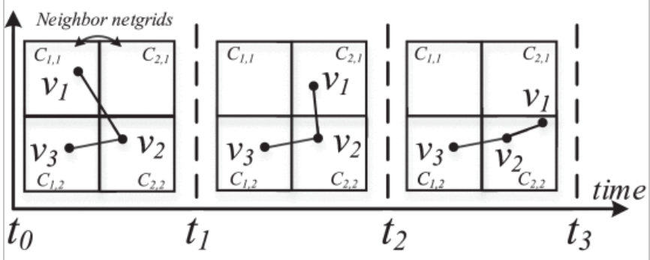
Definition
In TNM, the first step is to divide the whole space where satellite's orbit exists into a number of cubes. After the space partition, the location of each satellite in the network can be indicated by the discrete cube (i.e., netgrid). Meanwhile, the specific time slot that a satellite stays in each netgrid should also be recorded. By doing so, the satellite's trajectory can be described as a continuous time ordered set of discrete netgrids.
Notes:
那在這篇提出的叫做TNM 是temporal netgrid based model，他是將空間分割成立方體，並用網格來表示衛星所在位置而不是座標，同時會記錄每個衛星在每個網格中停留的進入與出去的時間，像是可以看到在t0~t1時 v1是落在C1,1 而在t1~t2時 v1離開c1,1來到 c2,1，因此可以知道每個衛星在任何時間的位置

Slide 13


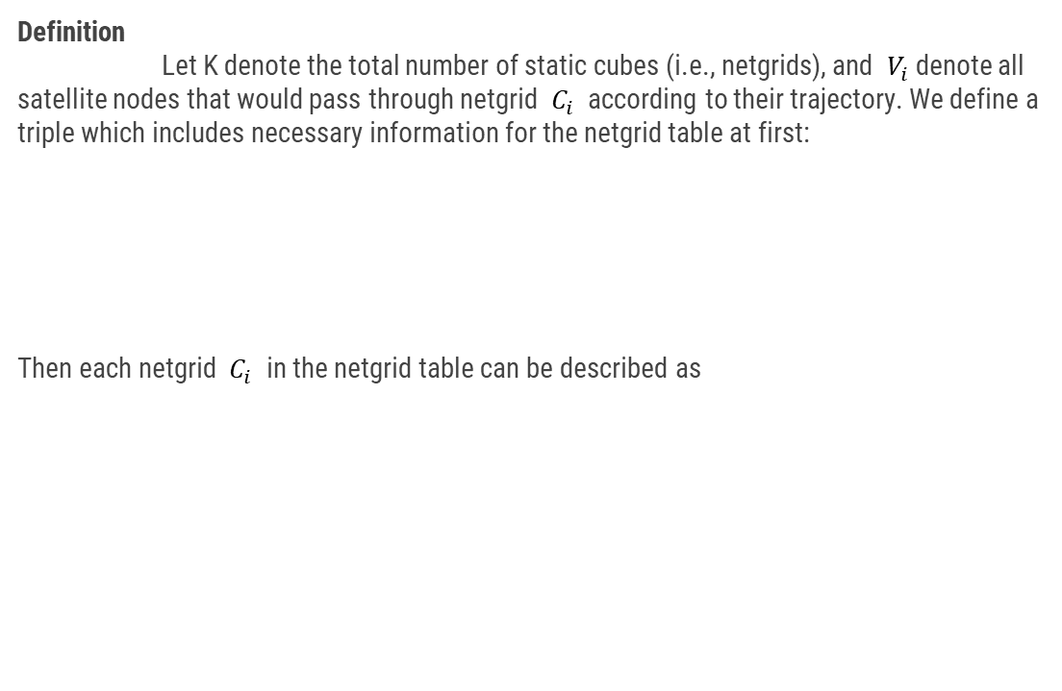
Definition
Let K denote the total number of static cubes (i.e., netgrids), and $V_{i}$denote all satellite nodes that would pass through netgrid $C_{i}$ according to their trajectory. We define a triple which includes necessary information for the netgrid table at first:
Then each netgrid $C_{i}$ in the netgrid table can be described as
Notes:
為了要保存這些訊息，要建置一個tuple ， 裡面要存的是衛星編號，衛星週期，以及進出的時間， 然後將這些訊息放入netgrid Ci 然後所有的ci會組成一個netgrid table

Slide 14
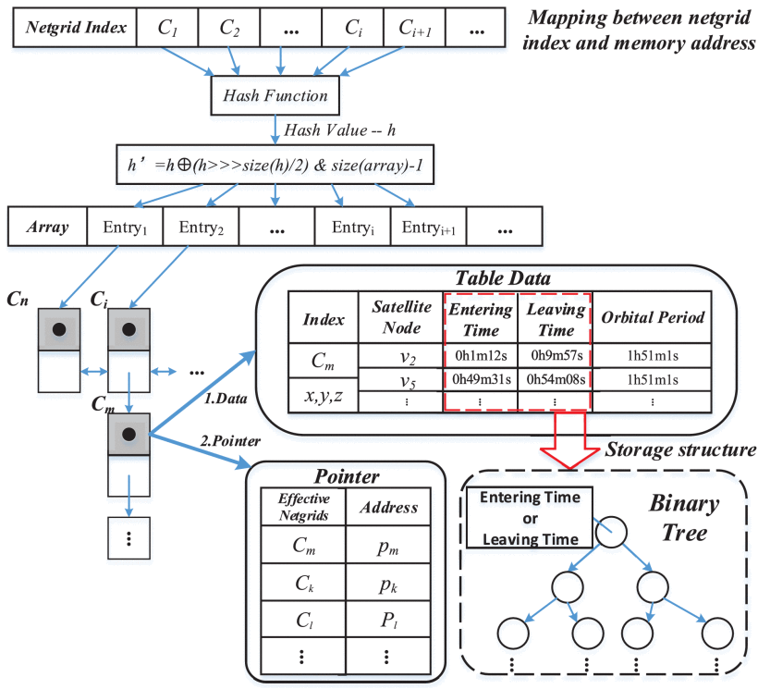
Data structure
Notes:
為了加速搜尋netgrid，這邊使用hashmap 來分配memory address. 每個netgrid 要mapping到一個array entry 中 但是透過hash function 還是會有機會隊到同一個array ，所以會用linked list去串後來也map到同樣entry的netgrid, ，

Slide 15
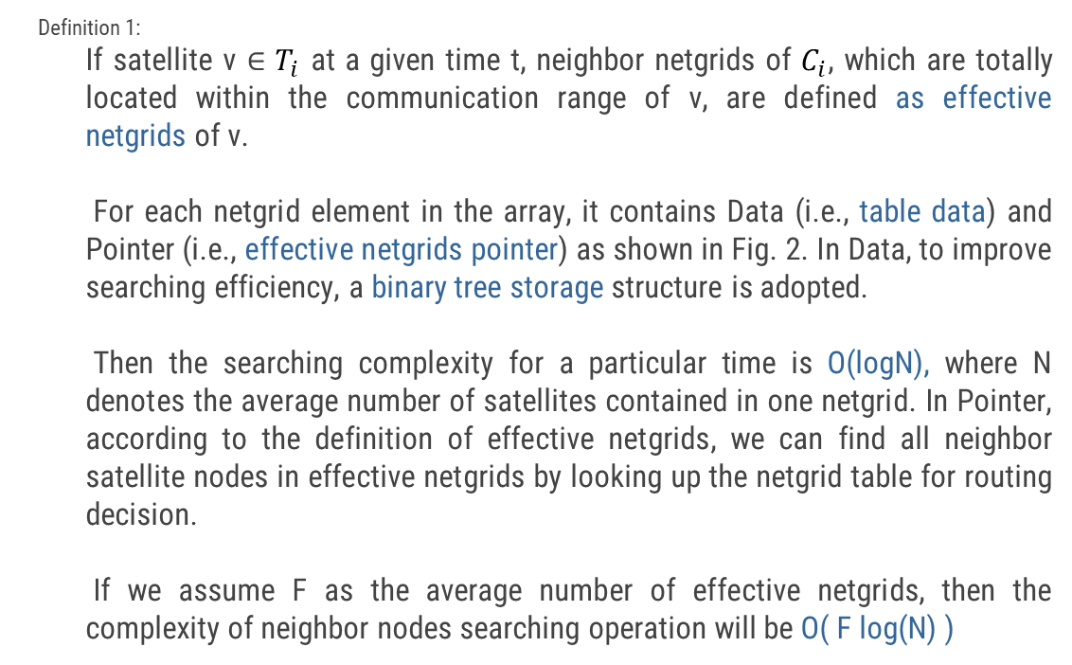
Data structure
Definition 1:
If satellite v ∈ $T_{i}$ at a given time t, neighbor netgrids of $C_{i}$, which are totally located within the communication range of v, are defined as effective netgrids of v.
For each netgrid element in the array, it contains Data (i.e., table data) and Pointer (i.e., effective netgrids pointer) as shown in Fig. 2. In Data, to improve searching efficiency, a binary tree storage structure is adopted.
Then the searching complexity for a particular time is O(logN), where N denotes the average number of satellites contained in one netgrid. In Pointer, according to the definition of effective netgrids, we can find all neighbor satellite nodes in effective netgrids by looking up the netgrid table for routing decision.
If we assume F as the average number of effective netgrids, then the complexity of neighbor nodes searching operation will be O( F log(N) )
Notes:
如果satellite v 在給定的時間點t ，他鄰近的netgrid 若位於v的通訊範圍內，則將這些netgrids定義為v的effective netgrids. 裡面會存table data也就剛剛講到要存的資料，就是衛星編號，進出這個netgrid的時間以及衛星週期。
然後為了加快搜尋於是用二元樹讓每查找的時間複雜度變為O(logN) ，若總共要查的netgrid數量為F，則整個搜尋過程複雜度為O(Flog(n))

Slide 16
04
Multi-Layer Netgrid Partition Method in Large-Scale SSNs

Slide 17
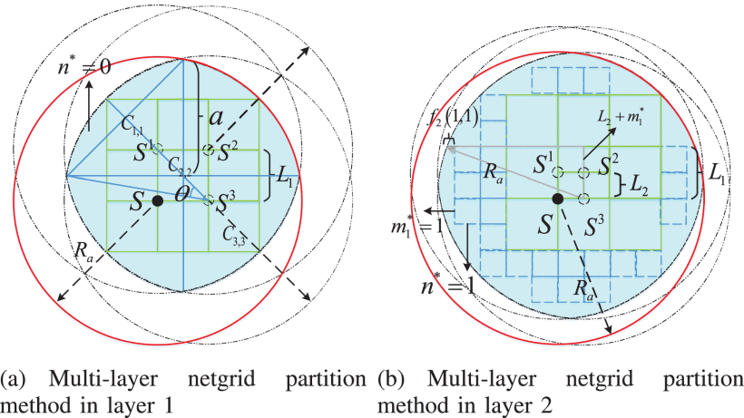
Notes:
因為儲存的方式變成用網格來記錄衛星位置，因此看到左邊這張圖，假設我知道我的衛星在C22的netgrid之中，但實際上我不知道他到底是在這個netgrid的哪裡，為了確保你在這個網格內任何位置都可以進行通訊，我們就要找出可接受的最小通訊半徑。
可以看到S, S1,S2,S3 分別代表netgrid C2,2 ，4個角落的位置，我們將這4個點為圓心，以通訊半徑畫出四個圓，重疊的部分就是藍色的區域，接著就是用微積分算出他們的共同通訊範圍，因為這張圖是平面的，所以看起來很簡單，但實際上是立體的類球體，中間有一部份內容都是數學在算那個球體，所以我這邊只講他想表達的概念，也就是說當我們把netgrid的長度單位變小，我們就可以得到更精確的通訊範圍，右邊的部分就是將原本的netgrid長度變1/2，可以看到藍色面積有變大。
，

Slide 18
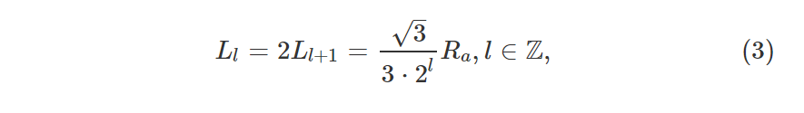

Netgrid Partition
Let $L_{l}$represent the side length of a cube (i.e., netgrid) in layer l, and $R_{a}$ represent the communication radius of each satellite node. Then the side length of each netgrid in different partition layer l should be
Notes:
他把不同的netgrid長度單位叫做第一層、第二層、以此類推，那以下就是層根通訊半徑的關西式 。Ra就是通訊半徑。

Slide 19
05
Netgrid-Based Shortest Path Routing Algorithm

Slide 20
Beacon Protocol
The beacon protocol is proposed by taking into account two factors. One is to adapt the dynamic environments in satellite networks, such as unpredictable link interruption and node failure.
The other is to diminish the influence of the accuracy sacrifice in TNM. In short, the basic idea of the beacon protocol is to collect status (e.g., queuing delay, transmission rate and so on) of neighbor satellites periodically for routing decision.
In the beacon protocol, each satellite node will broadcast beacon packet periodically. When the other satellite nodes receive the beacon packet for the first time, they will mark the sender as an alive neighbor and save the corresponding information contained in beacon packet.
In order to detect link interruption and node failure, alive neighbor v will be deleted after three broadcast periods unless a new beacon packet broadcasted by v is received.
Notes:
有兩個原因讓作者提出beacon protocol ，第一點是為了要適應衛星網路中的動態環境，譬如不可預測的link interruption ，或是node failure等等，第二個是要減少TNM中精度犧牲的影響。總而言之beacon protocol的主要目的是定期蒐集鄰居衛星的狀態以進行路徑選擇，譬如queuing delay , transmission rate 等等。在beacon protocol中，每個衛星會定期廣播自己的beacon package 當其他衛星收到後會將發送者設為alive neighbor，並保存beacon package夾帶的相關訊息(例如廣播週期跟transmission rate等等)，為了要偵測link interruption 跟 node failure 經過3個傳輸週期後，若過程中沒有再收到他的訊號，則將此neighbor刪除。

Slide 21
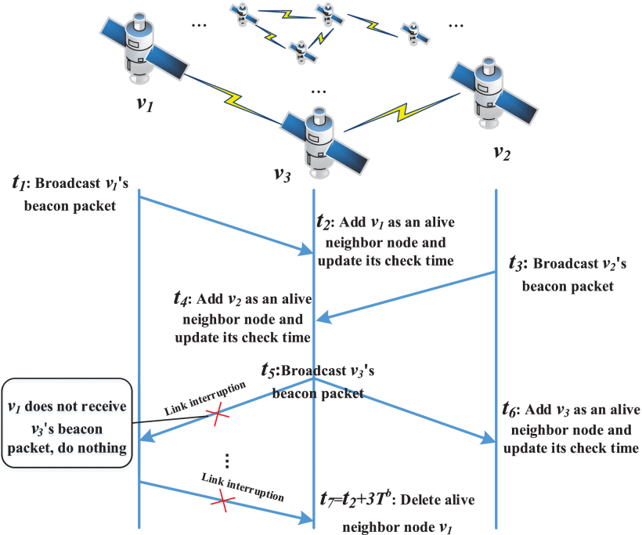

Slide 22
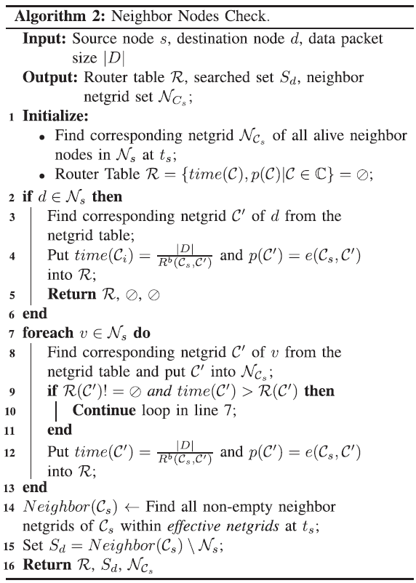
Routing Strategy
Neighbor Nodes Check
If d node is one of the alive neighbor, it could be transmitted directly.
If d node is not one of the alive neighbor, all of the alive neighbor’s netgrid will be added into search set S*.
Notes:
先來介紹他的演算法，首先要講的是neighbor nodes check，這邊主要負責的是找出netgrid的其他alive neighbor。首先先檢查目標點 d 是不是一開始就是他的alive neighbor，如果剛好就是，就先將d的所處的netgrid加到netgrid table中然後將傳輸所需要的時間以及路徑加入到router table中 ， 若d不是alive neighbor，則先遍立每個alive neighbor node v ，將v所屬netgrid C’ 加入neighbor netgrid set, 並檢查在這次建置走到此netgrid的router table是否小於之前所要花的時間，
如果新的router table所需的時間比較短，就把它更新。也就是這邊做完就會會找到從source node到所有附近有效鄰居netgrid的最短路徑。

Slide 23
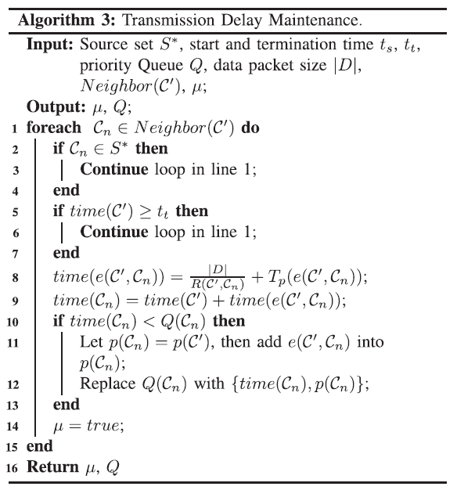
Routing Strategy
2) Transmission delay maintenance
If new total time < total time
total time = new total time
Notes:
再來是他這邊要維持一個priority queue, 也就是要把neighbors裡面cost 最小的排最前面， 第一步先從neighbor裡找到非原本set的netgrid，並且它的傳輸時間小於給定的結束時間，然後計算預計的傳輸時間 (也就是transmission delay + propagation delay)， 那如果新的傳輸時間大於舊的就將傳輸時間跟路徑更新到Queue上。

Slide 24
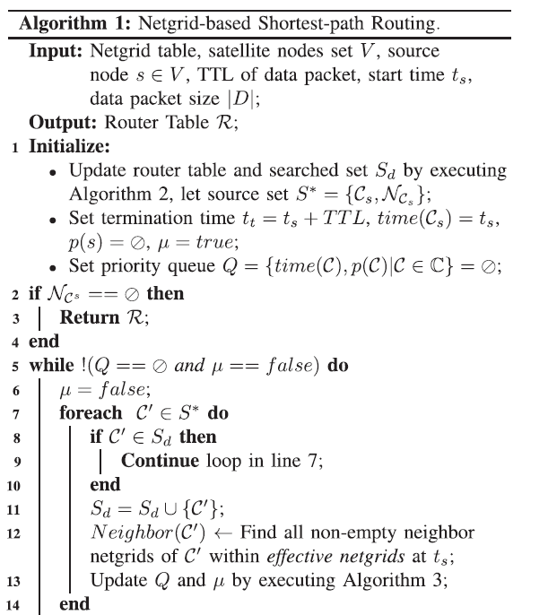
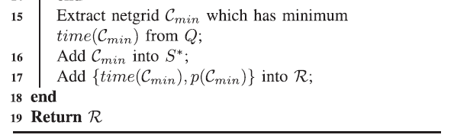
Netgrid-based shortest-path routing
Notes:
一開始先初始化就是先利用剛剛介紹的第一個演算法來找尋附近neighbor，來update它的router table, 並且設定結束時間為開始時間+一個TTL time
先從source node 開始找與source點的neighbor中找到一個在search set Sd 的netgrid C’， 並把C’加入到Sd中 接著找出 C’在ts時的effective neighbor netgrid. 然後執行第二個介紹的演算法來update priority queue, 重複執行直到都找完所有鄰居，然後所有都找完以後再從那個priority queue裡提取第一個netgrid，並加入到routing table重複此步驟直到queue為空，然後再重新開始下一輪。其實就跟dijkstra很像

Slide 25
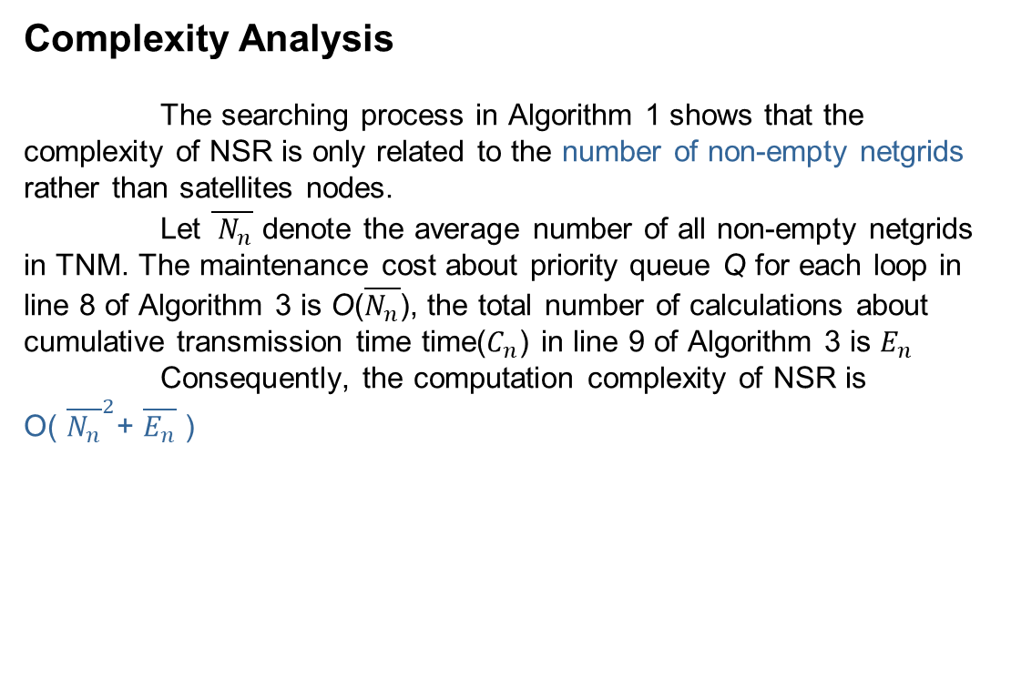
Complexity Analysis
The searching process in Algorithm 1 shows that the complexity of NSR is only related to the number of non-empty netgrids rather than satellites nodes.
Let $\overline{{ N}_{n}}$ denote the average number of all non-empty netgrids
in TNM. The maintenance cost about priority queue Q for each loop in line 8 of Algorithm 3 is O($\overline{N_{n}}$), the total number of calculations about cumulative transmission time time($C_{n}$) in line 9 of Algorithm 3 is $E_{n}$
Consequently, the computation complexity of NSR is
O( ${\overline{N_{n}}}^{2}$+ $\overline{E_{n}}$ )
Notes:
那它跟dijkstra最不一樣的就是他不用走所有的點，只要走non–empty netgrid 就好，因此複雜度相對較低， 如果說 $\overline{{ N}_{n}}$ 是平均的 non-empty netgrid數量的話，維持一個priority的時間複雜度是O($\overline{{ N}_{n}}$)，每次其實都要找一次所有的non-empty netgrid 而計算每次的傳輸時間就要用到En ，所以總時間複雜度就是O(N平方+E)，優點就是他不會因為衛星的數量改變他的時間複雜度，他的時間複雜度是根據你的netgrid定的大小 也就是 前面所說的層級概念，層級越高 精準度越高，時間複雜度也變高，因為netgrid數量變多。

Slide 26
06
SIMULATION RESULTS

Slide 27
Compare
Proposed routing (NSR): NSR algorithm based on TNM in partition layer 2 and layer 3 is performed, respectively. NSR will be firstly executed at the source node to find the optimal routing path. If multi-choice satellites in the path are unreachable, NSR will be executed at intermediate node to find another routing path.
TGM based Source Routing (TSR): TSR only executes routing algorithm once when user's data packet arrives at the source node, and the intermediate nodes only forward the packet by extracting the predetermined routing path information from the packet header.
Contact Graph Routing (CGR): CGR utilizes Dijkstra's SPF algorithm based on the scheduled contact plan, and it executes routing algorithm at each intermediate node during the transmission from the source node to the destination node.
TGM based Brute-force Routing (TBR): TBR adopts brute-force method based on the topology information of TGM to find the optimal routing path, it executes brute-force algorithm at each intermediate node during the transmission.
Notes:
接下來會比較以下四種求路徑的演算法，第一個NSR就是這篇提出來的，第二個是TSR，那它只會在一開始做一次路徑規劃，第三種是CGR，它是直接用node 來使用dijkstra, 第四種是TBR，他算是暴力解，因為它在每一步節點重新做最佳的路徑規劃。

Slide 28
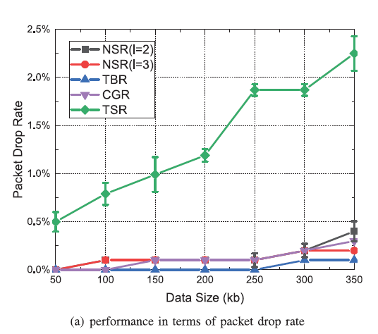
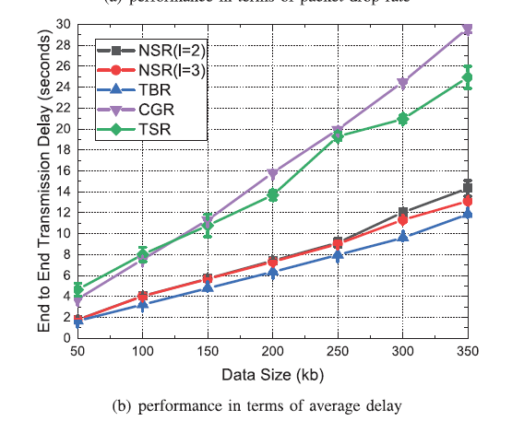
Notes:
那可以看到左邊封包丟失率的表現，越高代表越不好，綠色是TSR，也就是只做一次規劃，藍色是暴力解，想當然它的路徑最好，因此封包遺失率很低，大部分情況下，NSR 2跟3表現差不多，但當data大小超過300KB時，2的性能相較下降。然後比較transmission delay， 當packet數量多的時候，transmission delay上升原因是因為當packet 數量多時，topology改變的機會變高， 對於TSR，因為只做一次路徑規劃，所以當topology改變時，中間的link可能已經斷開，只能等到他們重新連結或TTL時間到。

Slide 29
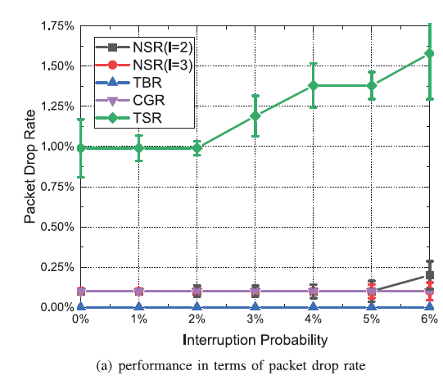
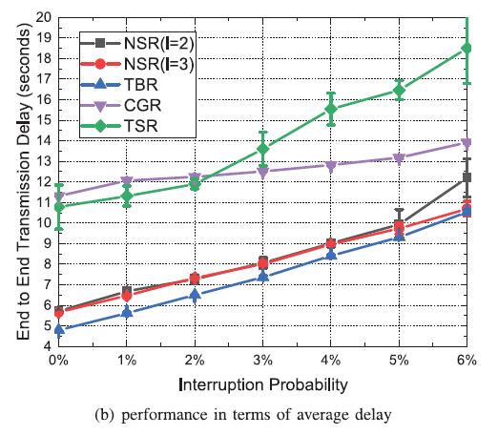
Notes:
由於考量到衛星的複雜環境，可能會產生link 的中斷，因此也要評估這些路由方法處理link interruption的能力。可以看到TBR、NSR、CGR的丟包率比較穩定，原因是因為他們可以在中間發生中斷時重新執行routing process 以代替原先的路徑，然後右邊的點對點傳輸延遲也是一樣道理，然後作者說他們的實驗結果發現這種routing scheme不管在甚麼中斷機率下，都很接近TBR 也就是暴力最佳解，因此說明了NSR的魯棒性

Slide 30
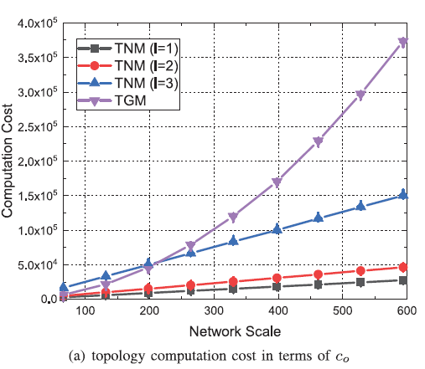
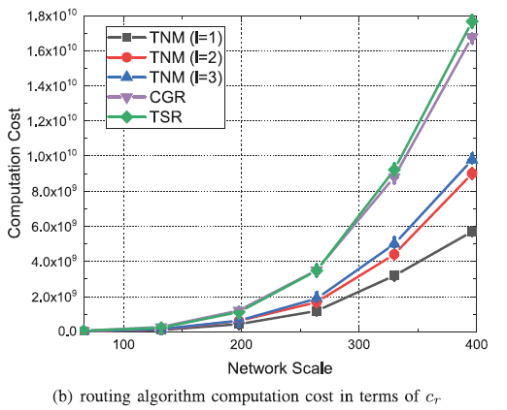
Notes:
最後去比較TNM與TGM 在不同網路規模下的computation cost, 可以看到當網路規模越大，TNM與TGM在計算topology以及routing algorithm的差異越明顯，

Slide 31
Conclusion
In this paper, we developed an efficient and low-complexity routing scheme for large-scale SSNs. Firstly, we proposed a novel topology description model named TNM to describe the time-varying network topology of large-scale SSNs. By using discrete netgrids to locate satellite and multi-layer netgrid partition method, TNM can provide time-continuous topology information and alternative description accuracy to support random traffic transmission requirements. Based on the topology information provided by TNM, we also proposed a netgrid-based routing algorithm to find the optimal path in large-scale SSNs. Thanks to the status collected by the beacon protocol, NSR has the ability to adjust routing path according to the status of neighbor satellites.
Notes:
總結就是 它們為大規模小型衛星提出了一種新的路由方案，透過本篇提出的一種可以提供時間連續的拓樸訊息圖 TNM，以及beacon protocol來根據鄰居衛星的狀態來動態調整路徑，那根據實驗結果表明所提出的方法能夠以較低的計算成本達到最優的路由性能。

